Slide 1
Using bioinformatics tools to validate your AI/ML results
Notes:
Welcome to the lesson: “Using bioinformatic tools to validate your AI/ML results”. To set the stage, you’ve just run a machine learning pipeline which has identified some genes most predictive of a phenotype. Now you want to determine what is the biological function of the genes you found. If the genes are involved in physiological processes which are known to be associated with your phenotype, then that serves to validate your results. Moreover, knowing which genes are implicated in these deleterious physiological processes provides a molecular target for diagnosis, monitoring, and potential therapy.

Slide 2
Objectives
Perform differential gene expression analysis
Perform pathway enrichment analysis
Perform gene set enrichment analysis
Notes:
The objectives of this lesson are to perform differential gene expression analysis, perform pathway enrichment analysis, and perform gene set enrichment analysis.

Slide 3
Perform differential gene expression analysis
Notes:
In this first section, we describe how to perform differential gene expression analysis.

Slide 4
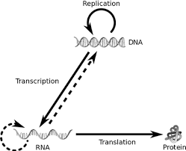
Recall the central dogma of biology
Notes:
The so-called central dogma of molecular biology defines the flow of information from DNA to proteins through an intermediate form called RNA. DNA itself is a double-stranded molecule residing inside the nucleus. When a protein needs to be expressed, the gene or genes that comprise that protein are transcribed into RNA inside the nucleus. RNA are single-stranded molecules with a slightly different molecular composition than DNA. The RNA fragments are further processed and exported out of the nucleus and into the cytoplasm where they are translated into proteins, one amino acid at a time.
DNA also undergoes replication during cell division, as shown in the diagram.
RNA sequencing is the process of isolating, amplifying, and counting these RNA transcripts to see which genes are “active” in a cell or tissue at a particular point in time.

Slide 5
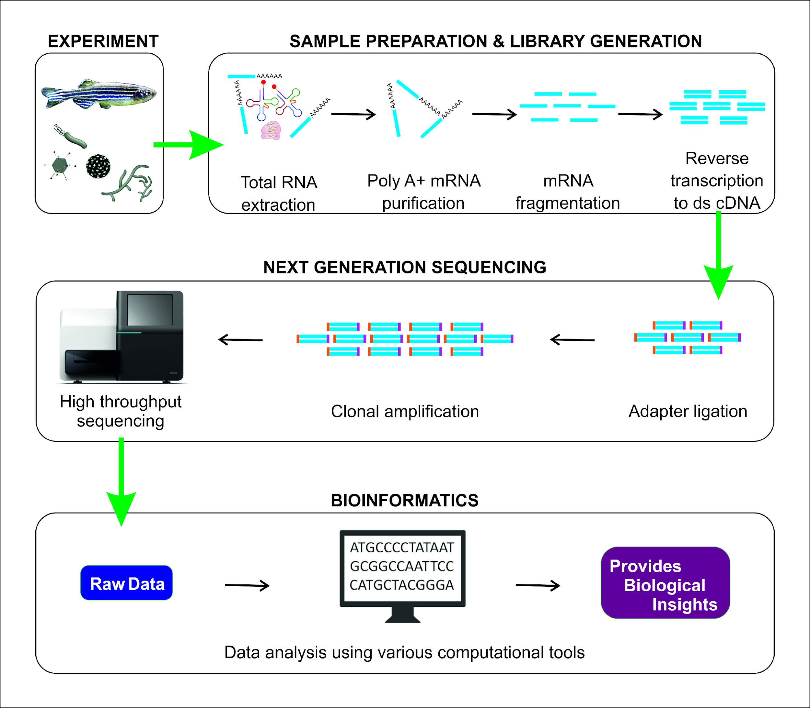
Recall RNA-seq
Wet lab
Dry lab
https://www.mdpi.com/1422-0067/19/1/245
Notes:
RNA sequencing has 2 primary components – a wet lab component where chemical reactions are used to extract, purify, amplify, and sequence RNA fragments; and a dry lab component where those RNA fragments are quantified and analyzed.

Slide 6
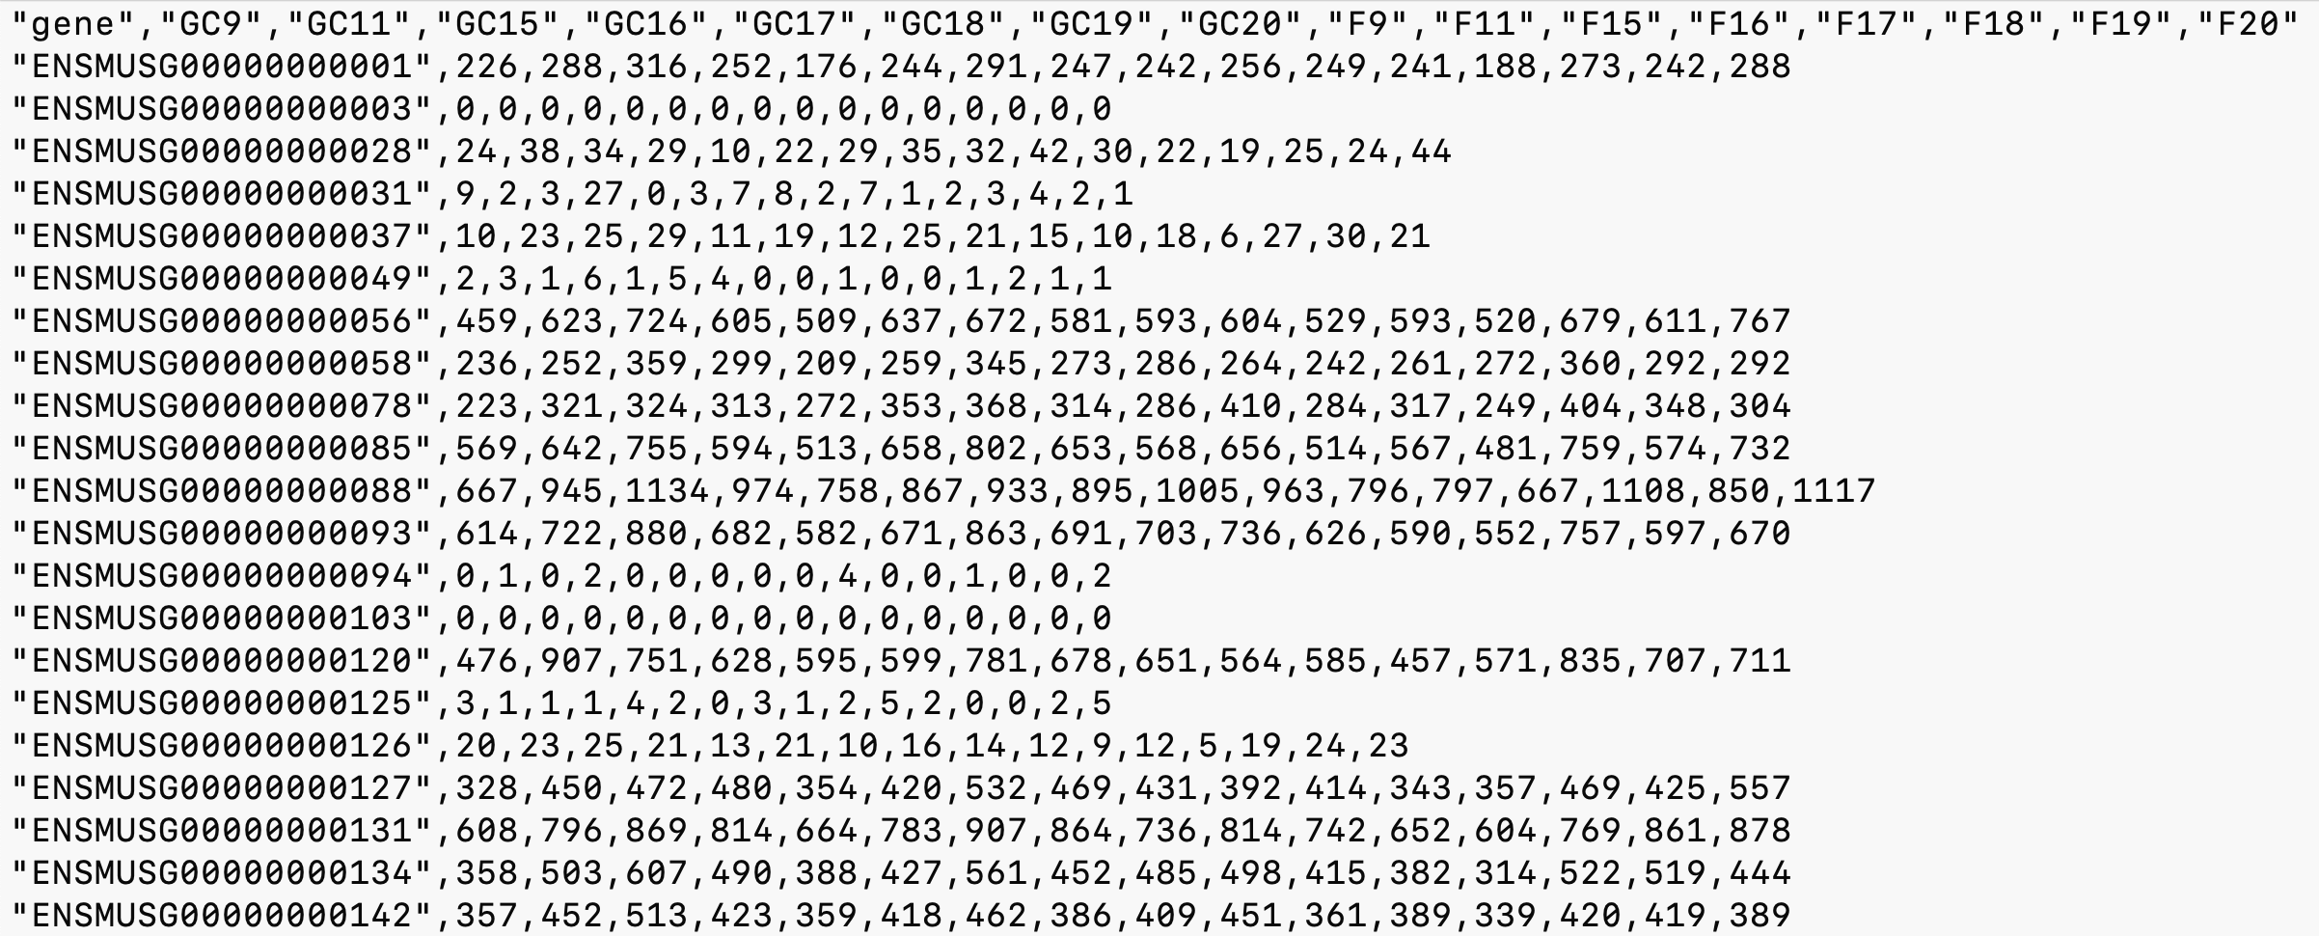
Recall RNA-seq prepared data
357 = number of RNA transcripts of gene ENSMUSG000000142 found for sample GC9
389 = number of RNA transcripts of gene ENSMUSG000000142 found for sample F20
Notes:
After the RNA transcripts have been prepared, their counts are stored in a table such as what is shown in the slide. In this slide, ground control sample GC9’s gene ENSMUSG142 has 357 transcripts, whereas flight sample F20’s count for the same gene is 389. Is the collective difference between all the ground control samples and all the flight samples statistically significantly different for this gene or any other gene? That’s the question that differential gene expression analysis answers.

Slide 7
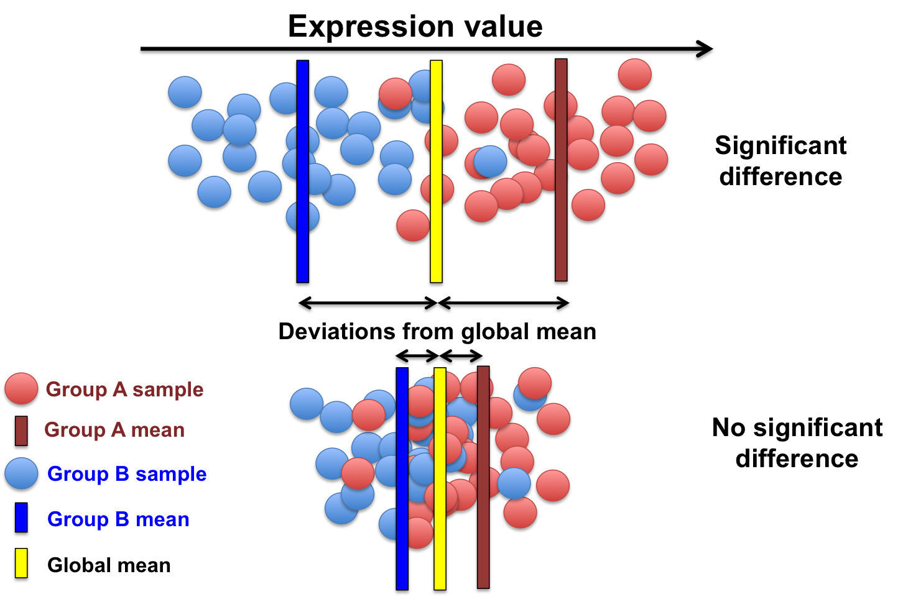
What is differential gene expression analysis (DGEA)?
Notes:
Differential gene expression analysis is a statistical experiment scientists perform on RNA-seq count data. There are 2 groups of interest, say A and B, one of which is the control group (to which no changes were made) and one of which is the experimental group (to which some changes were made). The experimental changes can be anything, such as treated (vs untreated), male (vs female), old (vs young), strain A (vs strain B), smoker (vs non-smoker), … etc . In our case, the experimental change is whether the organism was flown in space (i.e. “spaceflight”) or not (i.e. “ground control”). In our case, we wish to know if some genes are over- or under- expressed as compared to the baseline, and any such genes we will call “differentially expressed”. The biological explanation for differential expression is that the organism or system or tissue or cell is trying to compensate for the experimental change in order to maintain homeostasis in cells, organs, and systems.

Slide 8
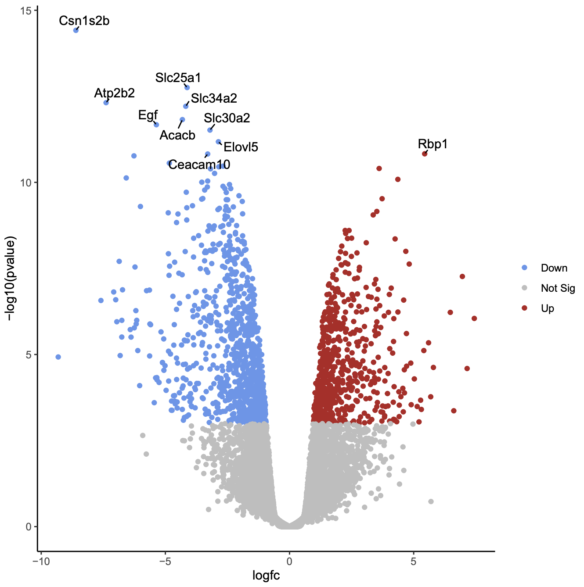
How do you visualize DGE? (volcano plot)
log2fc = log2 (countA/countB)
e.g. countA = 128, countB = 8
log2fc = log2(128/8) = log2(16) = 4
countA < countB | log2fc < 0
countA = countB | log2fc = 0
countA > countB | log2fc > 0
Notes:
The most intuitive way to visualize differential gene expression is to create what is called a volcano plot. A volcano plot, so named because perhaps it looks like an erupting volcano, has 2 axes: the horizontal axis represents fold change in log scale and the vertical axis represents the p-value in negative log scale.
Fold change (on the horizontal axis) is the ratio of the group A expression to the group B expression in log scale. So for example, if some gene has a mean count of 128 in group A and 8 in group B, the the ratio is 128/8 or 16, and the log base 2 of 16 is 4. A log2fc of 0 is when the mean count of group A is equal to the mean count of group B. A negative log2fc occurs when the group A expression is less than the group B expression because the log of a number less than 1 is negative. The further to the right is the higher the over-expression and the further to the left is the lower the under-expression.
P-value (on the vertical axis) represents the overall statistical significance of that expression value relative to all the other gene expression counts. We use the negative log of the P-value because the p-value is a number between 0 and 1, and so the log of a number between 0 and 1 is negative and we want our plot to sit in the first quadrant of the plane. The higher the value on the vertical axis, the more statistically significant the fold change.
In all, then, the further up and to the right or the further up and to the left are the most significantly differentially expressed genes.

Slide 9
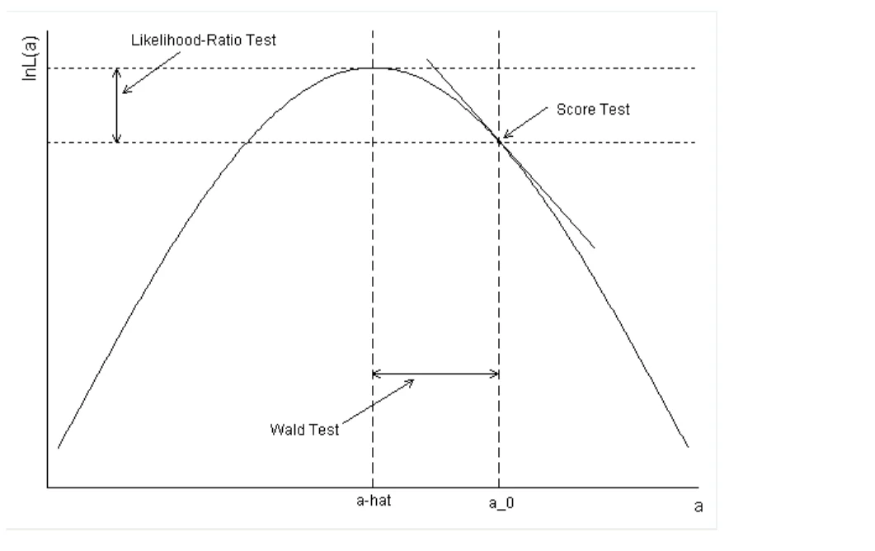
How does DGEA work?
hypothesis test:
H0: a_hat = a_0
H1: a_hat = a_0
https://www.bioconductor.org/packages/release/bioc/vignettes/DESeq2/inst/doc/DESeq2.html
Notes:
DGEA frames the question: is the observed gene count a_0 significantly different than the mean a-hat? as a hypothesis test. The null hypothesis H0 states they are not significantly different, and the alternative hypothesis H1 states they are significantly different. In general, we don’t care if a_0 is significantly greater than or significantly less than a-hat, so we measure the unsigned distance. This is also called a 2-sided test.
First, we start by dividing all the LFC’s by their standard deviation to get a standard normal distribution. In this graph, a-hat represents the mean of this distribution and a_0 is the observed value of a gene count. The question is: how different is gene count a_0 from the mean a-hat? As you can see, there are 3 different ways to measure that: the likelihood ratio test, the score test, and the wald test. DGEA works differently depending on the software package implementation.
The package we will discuss in the next few slides is called DESeq2 and it provides both the LLR test and the Wald test. Let’s discuss the Wald test which is the default in DESeq2. The wald test calculates the probability of observing a z statistic at least as extreme as the observed value a_0 randomly. If the p-value is sufficiently small (i.e. less than 0.05), we reject the null hypothesis, accept the alternative hypothesis that the value a_0 is significantly different.

Slide 10
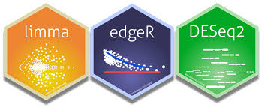


Which tools are available to perform DGEA?
Notes:
There are several tools available to perform DGEA, as shown in the slide. The tool we will use in our lab is the python implementation of DESeq2 called pydeseq. The other 3 tools shown in the slide (limma, edgeR, and DESeq2) are supported by an open-source project called Bioconductor and are implemented in R.

Slide 11
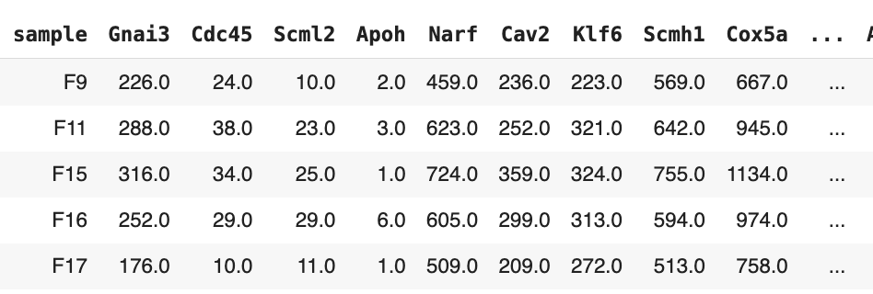
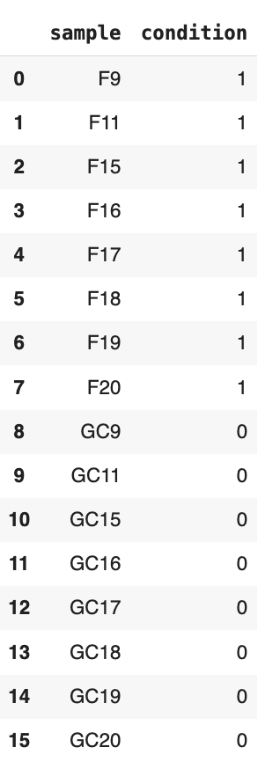
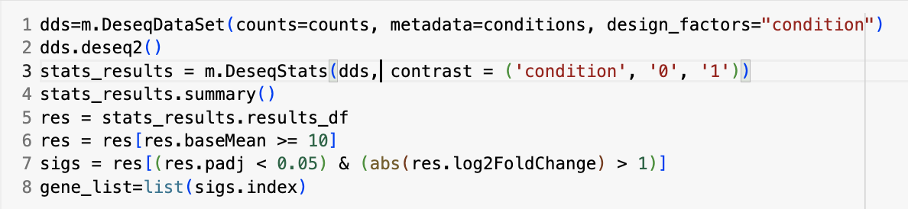
Example: perform DGEA using DESeq2
1
2
3
4
['Eps8l1','Irf7','Col4a1','Rgr','Pcdhgc5','Col4a4','Fat1','Cryab','Ptp4a1','Crybb2']
Notes:
In the first part, we first show on the left a table that associates for each sample F9, F11, … and so on up to GC20 a condition value of 0 (meaning ground control here) or 1 (meaning spaceflight here).
In part 2, we have our table of gene expression in which each row represents a sample (e.g. the first row is F9) and each column represents a gene (e.g. the first column is Gnai3). Each cell is the count of RNA transcripts for that gene for that sample, so 226 is the number of RNA transcripts measured for sample F9 for gene Gnai3.
In part 3, we show the sequence of python statements to execute the DESeq2 experiment which ultimately generates a list of statistically significantly differentially expressed genes. Recall that a differentially expressed gene may be “over-expressed” (meaning the experiment group’s mean expression is significantly higher than expected as compared to the control group) or “under-expressed” (meaning the experiment group’s mean expression is significantly lower than expected as compared to the control group).
In part 4, we show that list of 10 genes. Now the question is, so what do we do with this list of genes?

Slide 12
Now what do I do with this list of genes?
0. look up the genes online
(e.g. https://www.ncbi.nlm.nih.gov/gene/)
do pathway enrichment analysis
(e.g. http://bioinformatics.sdstate.edu/go/)
2. do gene set enrichment analysis
(e.g. https://www.gsea-msigdb.org/gsea/msigdb/annotate.jsp)
3. use them in conjunction with your AI/ML pipeline

Slide 13
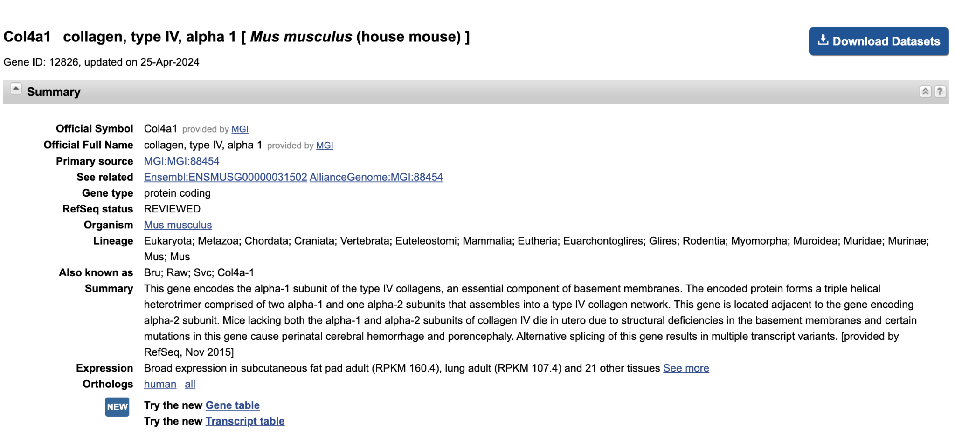
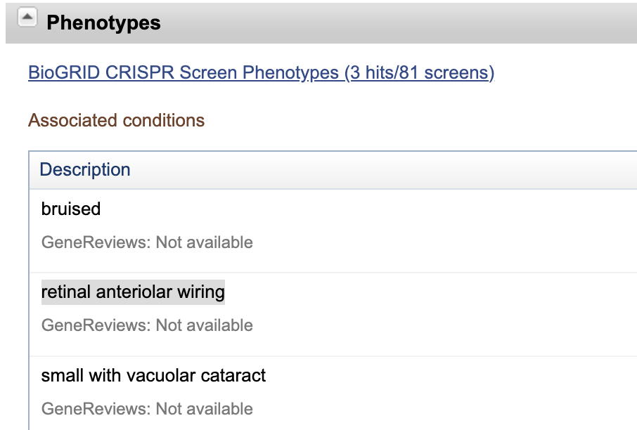
Look up the genes online
Notes:
The screen shot on the left shows the description of the Col4a1 gene of mus musculus. The summary describes the gene as a component in the synthesis of basement membranes. Scrolling further down this page shows phenotypes that have been observed regarding this gene, one of which has to do with the retina and the other with cataracts, both which are consistent with our observed phenotype of SANS.

Slide 14
How can I use DGEA with my AI/ML pipeline?
compare your AI/ML results to DGEA results
use DGEA to reduce dimensionality of feature space prior to doing AI/ML
use AI/ML to reduce dimensionality of feature space prior to doing DGEA
Notes:
As far as using DGEA in conjunction with AI/ML, there are a few ways you can incorporate these gene results. First, you can compare the results of your AI/ML model to the gene list you obtained from DGEA. Is there any overlap? If there is, what does that tell you about your AI/ML findings? Is there no overlap, and if not, what does that tell you about your AI/ML findings?
A second way to use DGEA with AI/ML is to use DGEA to reduce the number of genes under consideration in your AI/ML modeling. RNA-seq experiments typically have 20,000 or more genes, and having only a few ground control and spaceflight samples is not sufficient to determine the effect of each gene for each group. Dimensionality reduction is a method in AI/ML to reduce the number of features, and this is one method of dimensionality reduction.
Conversely, the third way to use DGEA with AI/ML is use AI/ML for dimensionality reduction (i.e. only use the genes that your model found predictive of your phenotype in your DGEA experiment).

Slide 15
Perform pathway enrichment analysis
Notes:
In this section, we’ll perform pathway enrichment analysis which is a particular type of gene set enrichment analysis in which we only consider molecular, cellular, and system-level gene pathways which are enriched by a set of genes. This is one technique which will answer the question: “now that I have a list of interesting genes, what do I do?”

Slide 16
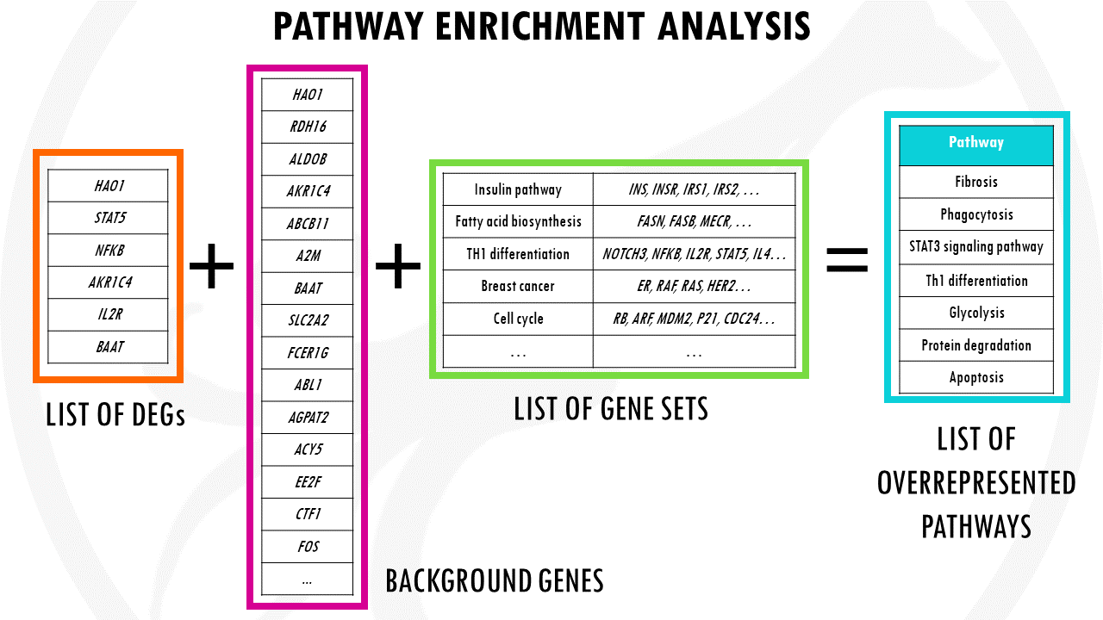
What is pathway enrichment analysis (PEA)?
Eps8l1
Irf7
Col4a1
Rgr
Pcdhgc5
Col4a4
Fat1
Cryab
Ptp4a1
Crybb2
Notes:
In pathway enrichment analysis, the goal is to determine whether a predefined biological pathway (e.g., a signaling cascade or a metabolic pathway) is overrepresented in a list of genes of interest compared to what would be expected by chance. This analysis helps to identify which pathways are potentially involved in the biological process under investigation. Pathway databases like KEGG, Reactome, and BioCarta provide predefined pathways that can be used for this analysis. In the slide, we see the list of our 10 differentially expressed genes (DEGs) Eps8L1, Irf7, Col4a1, and so on. We also provide the list of background genes which is the original set of all approximately 20,000 genes we used in the RNA-seq experiment. In the green box, we see a partial list of the gene sets which represent different biological pathways such as the insulin pathway, fatty acid biosynthesis, and so on. Each of those pathways has a set of genes which create proteins that are involved in that process. PEA, then determines if your list of DEGs is enriched in any of the gene sets to find over-represented ones. These over-represented pathways then are putative processes that are either either switched on (up-regulated) or switched off (down-regulated).

Slide 17
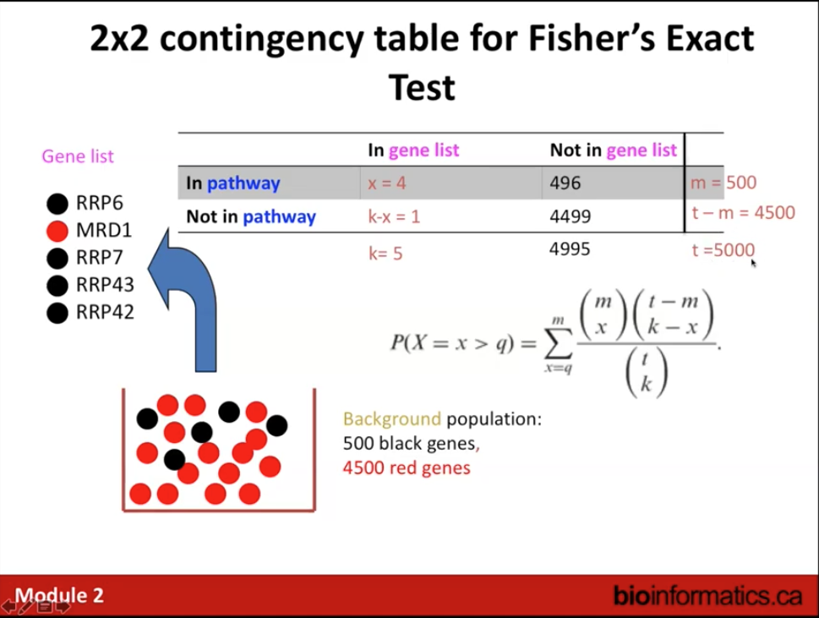
How does pathway enrichment analysis work?
m=500
t = 5000
x = 4
k = 5
p = 0.0005
“black” genes are in the pathway
“red” genes are not in the pathway
Notes:
Pathway enrichment analysis runs a Fisher’s exact test from a 2x2 contingency table to find whether the genes in the gene list are statistically significantly enriched in a pathway or not. In other words, what are the chances of drawing those genes given that they are in those pathways as opposed to drawing them completely by chance. The rows of a 2x2 contingency table define the two Boolean states (in the pathway, not in the pathway) and the columns define the two Boolean states (in the gene list, not in the gene list). To calculate the p-value, the expression is shown as a combinatorial sum of ratios. To calculate the value, just plug in the values for m (total number of genes in the pathway), for x (the number of genes in the gene list that are in the pathway), for k (the number of genes in the gene list), and for t (the total number of genes in and not in the pathway). Of course, these are very large numbers, and there are tools online (such as graphpad.com) that we can use to plug into a 2x2 contingency table and calculate p-value for fisher’s exact test. So Fisher’s exact test for this particular 2x2 contingency table representing the 5 genes in the list - 4 of which are in the pathway and 1 isn’t, the 500 genes total in the pathway and 4500 total genes not in the pathway, a p-value of 0.0005 is extremely significant. We would then conclude that this list of genes RRp6, MRD1, RRP7, RRP43, and RRP42 are significantly enriched in this particular pathway (whatever it represents).

Slide 18




Which tools are available to perform PEA?
Notes:
here is a subset of the commonly used tools to perform PEA. Note that Enrichr and DAVID do both GSEA and PEA. In the hands-on activity, we’ll be using shinyGO.

Slide 19
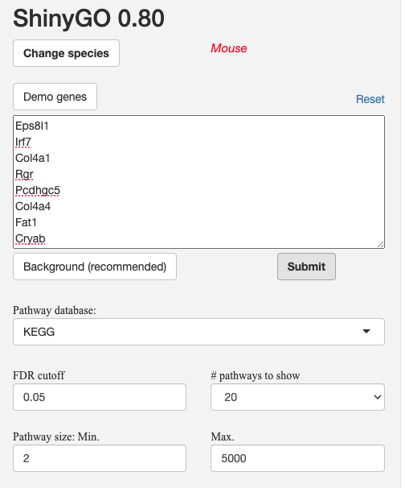
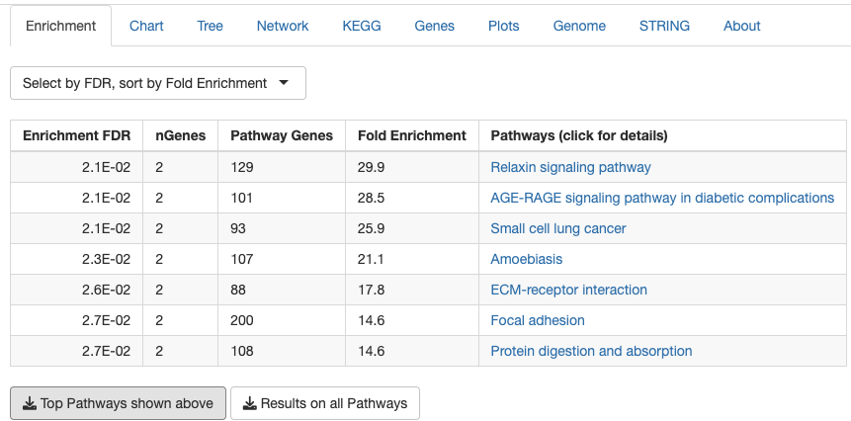
Example: perform PEA using ShinyGO
1
5
2
3
4
Notes:
The slide screen shots show an example of performing PEA using the ShinyGO online tool. In 1, you select the species (in our case, it’s mus musculus or mouse). In 2, you paste the list of genes you’ve found as “interesting”. In 3, you paste the list of “background” genes which is the list of all the genes you used as features in your DGEA or AI/ML model. In 4, you select the relevant pathway database (it defaults to the KEGG database). When you click the “submit” button, you’ll get a table of pathways which are statistically significantly enriched by your list of genes relative to the background genes. In this example, there are a number of pathways seemingly unrelated to our SANS phenotype based on the name. However, if you look more closely at each of these pathways, you’ll see that the 2 genes which enrich those pathways are the Col4a1 and Col4a4 genes, both of which are responsible for making collagen (the most abundant protein in the human body). Because our gene list comes from RNA-seq on retina tissue, we would then ask what is the function of collagen in the retina? For that you can use your favorite internet search engine to look at research papers which have explored the function of collagen in the retina and you would find that its primarily responsible for maintaining intraocular pressure – directly related to our SANS phenotype.

Slide 20
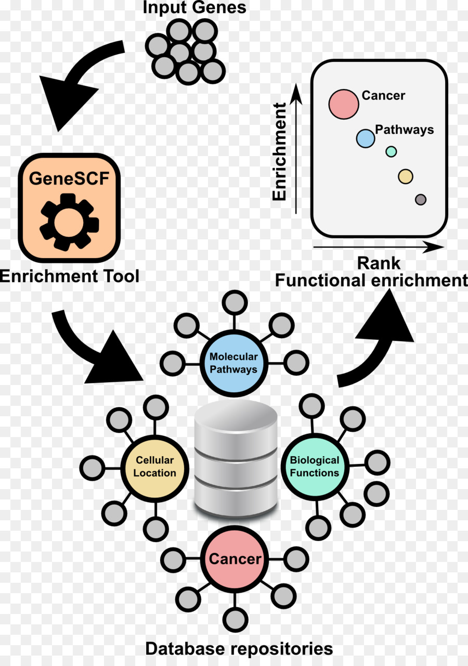
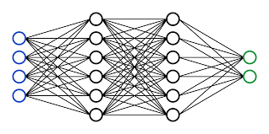
How can I use PEA with AI/ML?
ShinyGO
AI/ML model
do your AI/ML result genes enrich known pathways that relate to your phenotype?
Notes:
The graphic in the slide shows how one might use PEA with AI/ML in biomedical research in general. The AI/ML model will presumably give as its output a list of genes which are associated with a response (i.e. phenotype). Taking this list of genes and plugging them as input into a PEA tool such as ShinyGO will provide a list of pathways which are significantly enriched by the genes. The databases of pathways which are consulted are typically configurable by the PEA tool, so you may choose to restrict your search into only the databases you think are relevant to your phenotype. Once you get those functionally enriched pathways, you can begin exploring the scientific literature to see what effect those genes have in those pathways with respect to the phenotype you’re observing.

Slide 21
Perform gene set enrichment analysis
Notes:
In this section, we perform gene set enrichment analysis. This is a second technique which will answer the question: “now that I have a list of differentially expressed genes or genes from my AI/ML model, what do I do?”

Slide 22
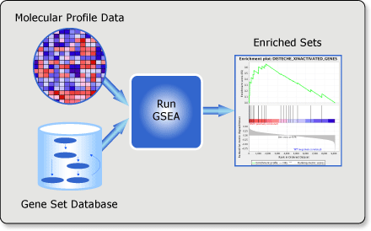
What is gene set enrichment analysis?
Notes:
Gene Set Enrichment Analysis (GSEA) is a computational method used to determine whether a predefined set of genes shows statistically significant, concordant differences between two biological states (e.g., phenotypes or conditions). Developed originally by the Broad Institute, GSEA is particularly useful for interpreting genome-wide expression data like that from RNA-seq experiments.
The primary goal of GSEA is to identify whether the members of gene sets (groups of genes that share common biological function, chromosomal location, or regulation) are randomly distributed across a ranked list of genes or primarily found at the top or bottom. This helps researchers understand whether particular functions or pathways are upregulated or downregulated in a given condition.

Slide 23
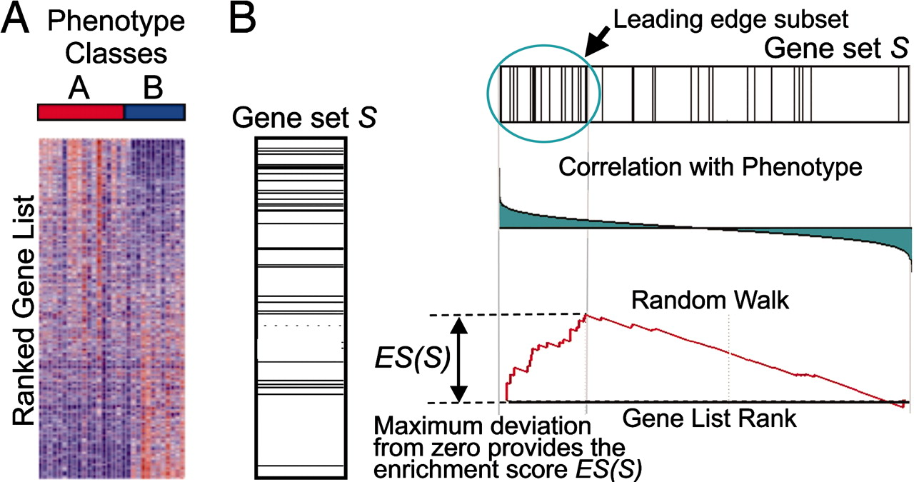
How does gene set enrichment analysis work?
https://www.pnas.org/doi/10.1073/pnas.0506580102
Notes:
Here’s a breakdown of how GSEA generally works:
Ranking the genes: First, genes are ranked based on their correlation with a specific phenotype or condition A vs B. This might involve metrics like the difference in expression levels between two conditions, or correlation with2 phenotypic traits.
Defining gene sets: Gene sets are defined based on prior biological knowledge, such as pathway databases (e.g., KEGG, Reactome), gene ontology terms, or other functional classifications.
Enrichment score (ES): GSEA calculates an enrichment score (ES) that reflects the degree to which a set of genes is overrepresented at the extremes (top or bottom) of the entire ranked list of genes. The score is essentially a running-sum statistic computed by walking down the list of genes: increasing the running sum when encountering a gene in the gene set and decreasing it otherwise.
Normalization and significance testing: The ES is then normalized to account for the size of each gene set. To determine the significance of the enrichment score, an empirical phenotype-based permutation test is typically used. This involves permuting the class labels of the samples and recalculating the ES for each permutation, forming a null distribution against which the actual ES can be compared.
Adjusting for multiple hypotheses: Because multiple gene sets are usually tested, GSEA also provides methods to adjust for multiple testing, such as the false discovery rate (FDR).

Slide 24
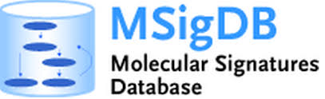

Which tools are available to perform GSEA?
Notes:
here is a subset of the commonly used tools to perform GSEA. Note that Enrichr and DAVID do both GSEA and PEA. In the hands-on activity, we’ll be using MSigDB.

Slide 25
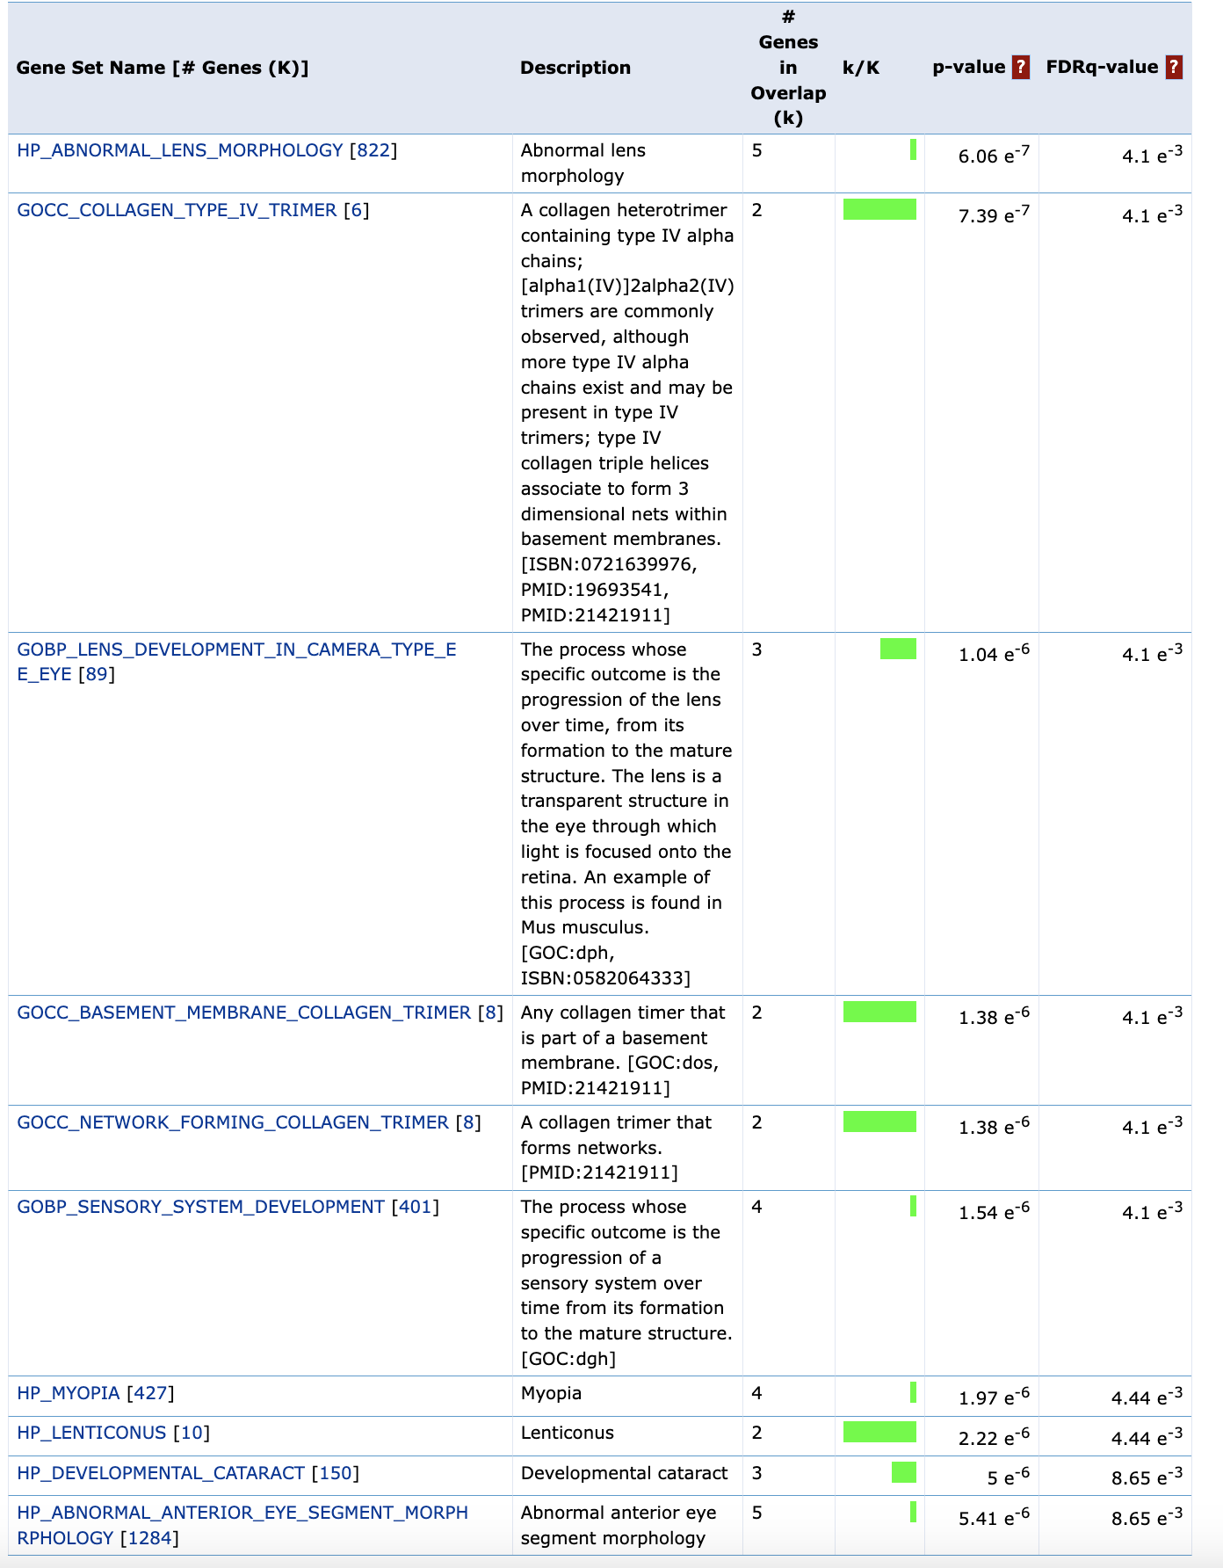
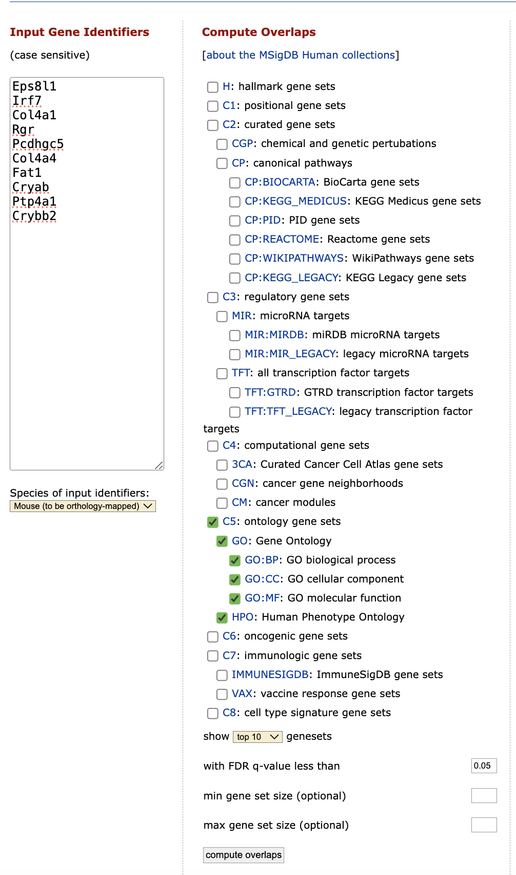
Example: perform GSEA using MSigDB
5
1
2
3
4
Notes:
The slides shows an example of performing GSEA using the MSigDB online tool. It’s a super simple interface to use. First you pasted a list of your genes into the text area. Second, you select the species (either human, mouse, or rat) in the drop-down list. Third, you select the gene sets you wish to explore (here we’ve selected C5 – all the ontology gene sets). After clicking the “compute overlaps” button in the 4th step, you’ll be shown the list of gene sets in 5 which were statistically significantly enriched by the gene list you provided. The gene sets are accompanied by a brief description, the number of genes in the overlap, the the FDR-adjusted q-value showing how statistically significant that overlap is. Recall anything below 0.05 is generally considered statistically significant in scientific research.
Looking more closely at the gene set names, you’ll notice that most of them have to do with abnormalities in eye function. Take the first one, for example, called HP_ABNORMAL_LENS_MORPHOLOGY. If I click that link, the MSigDB tool shows more information about that gene ontology term as well as the genes that comprise the gene set.
This phenotype is consistent with our hypothesis that spaceflight has a negative impact on neuro-ocular function. Moreover, these gene sets inform us as to how exactly the eye may have been impacted, giving us clues to pursue for further research into SANS.

Slide 26
How can I use GSEA with AI/ML?
MSigDB
do your AI/ML result genes enrich gene sets that relate to your phenotype?
Notes:
The graphic in the slide shows how one might use GSEA with AI/ML in biomedical research in general. The AI/ML model will presumably give as its output a list of genes which are associated with a response (i.e. phenotype). Taking this list of genes and plugging them as input into a GSEA tool such as MSigDB will provide a list of gene sets which are significantly enriched by the genes. The databases of gene sets which are consulted are typically configurable by the GSEA tool, so you may choose to restrict your search into only the databases you think are relevant to your phenotype. Once you get those functionally enriched gene sets, you can begin exploring the scientific literature to see what effect those genes have with respect to the phenotype you’re observing.

Slide 27

Notes:
And that brings us to the end of this lecture in which we discussed performing DGEA, PEA, and GSEA. In the hands-on activity, you’ll have the opportunity to experience using each of these tools and interpreting their results.

